Slide 1
Irregularly Inflected Forms (in the Target)
X ⟶ bake_{1.1} v pst ⟶ bake -d ⟶ baked
Y ⟶ take_{1.1} v pst ⟶ take -d ⟶ taked

Slide 2
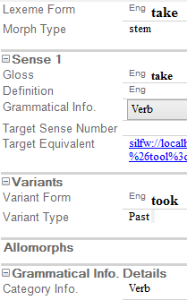
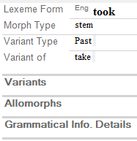
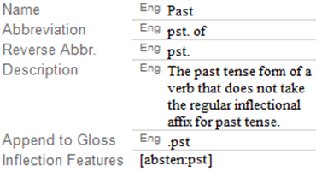
Y
take_{1.1} v pst
took

Slide 3
Swedish to German
äpple ⟶ Apfel (singular)
äpplen ⟶ Äpfel (plural)
dörr ⟶ Tür (singular)
dörrar ⟶ Türen (plural)

